Slide 1
Artificial Intelligence
Introduction

Slide 2
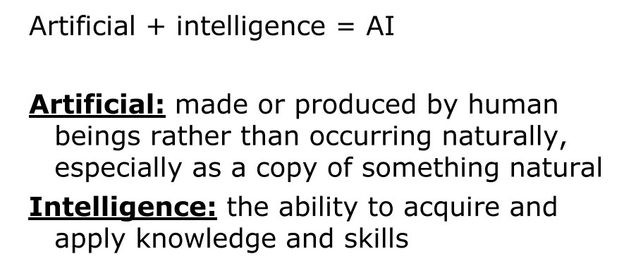
Artificial Intelligence

Slide 3
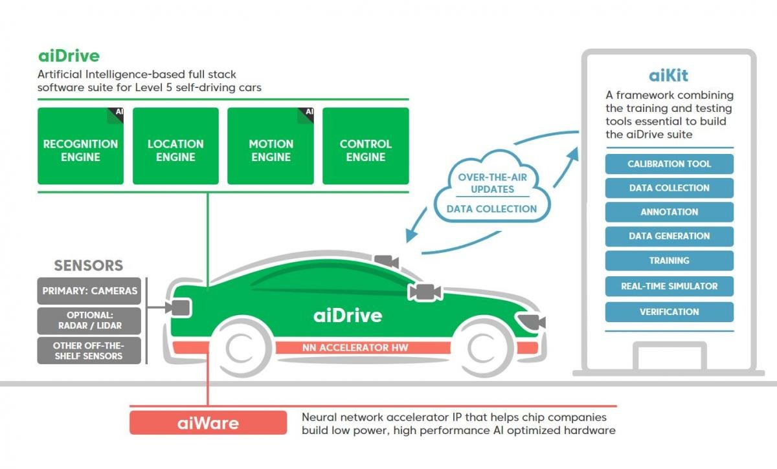
Autonomous car – example

Slide 4
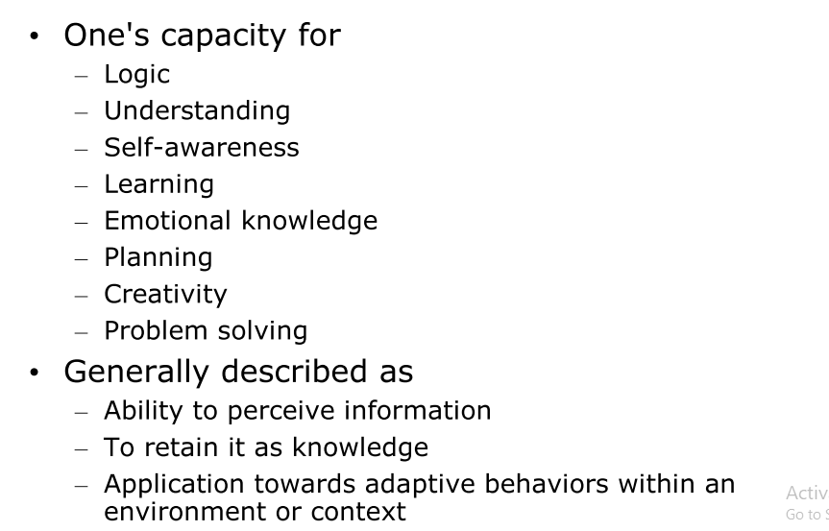
Intelligence

Slide 5
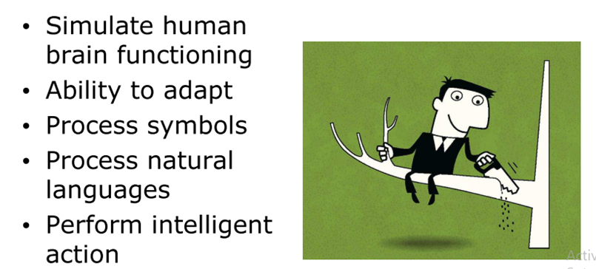
General characteristics of AI

Slide 6
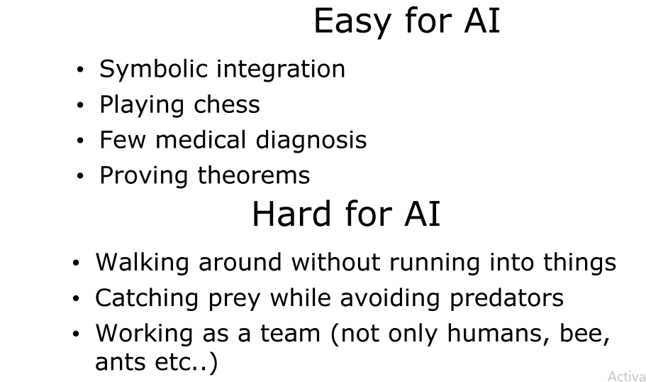
Challenges in AI

Slide 7
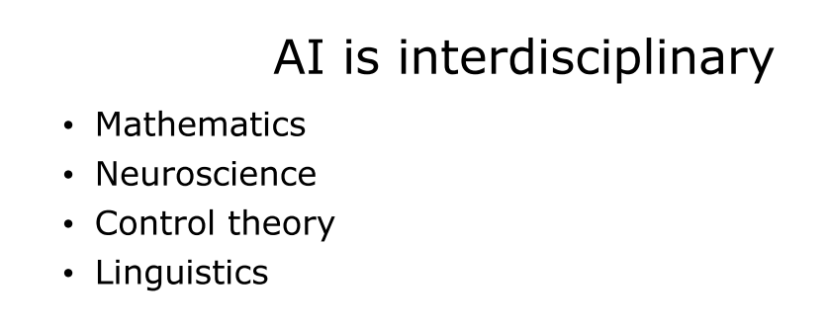
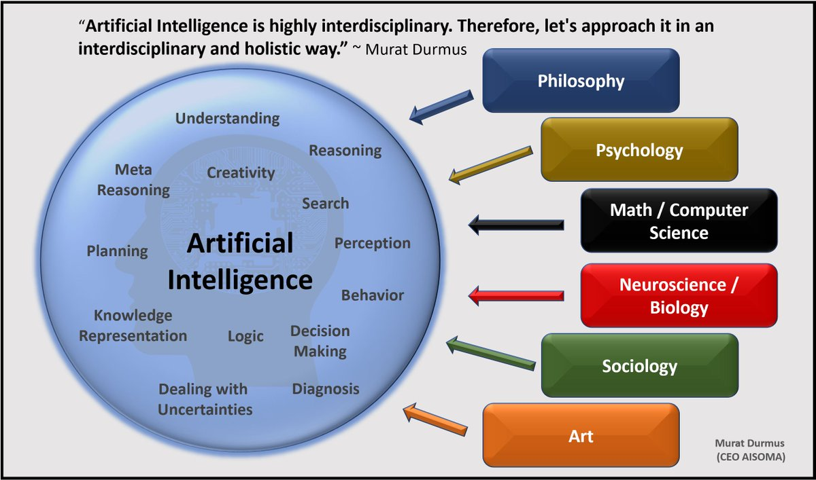

Slide 8
Areas of AI and Some Dependencies
Knowledge Representation
Search
Logic
Machine Learning
Planning
Expert Systems
NLP
Vision
Robotics

Slide 9
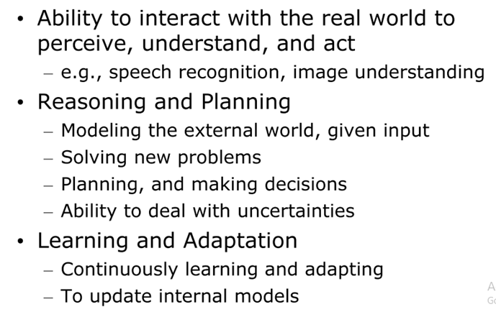
Elements of AI

Slide 10
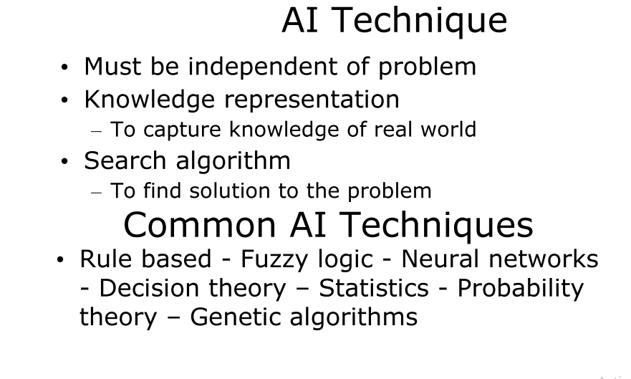
AI techniques

Slide 11
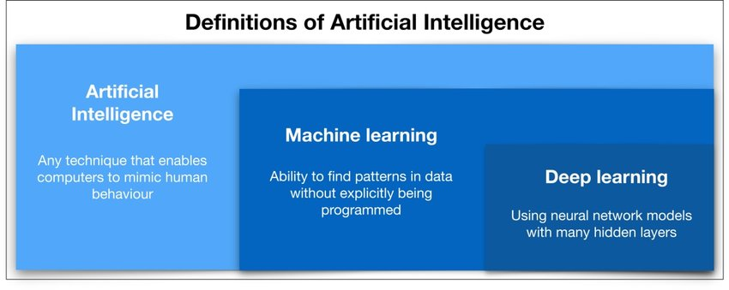

Slide 12
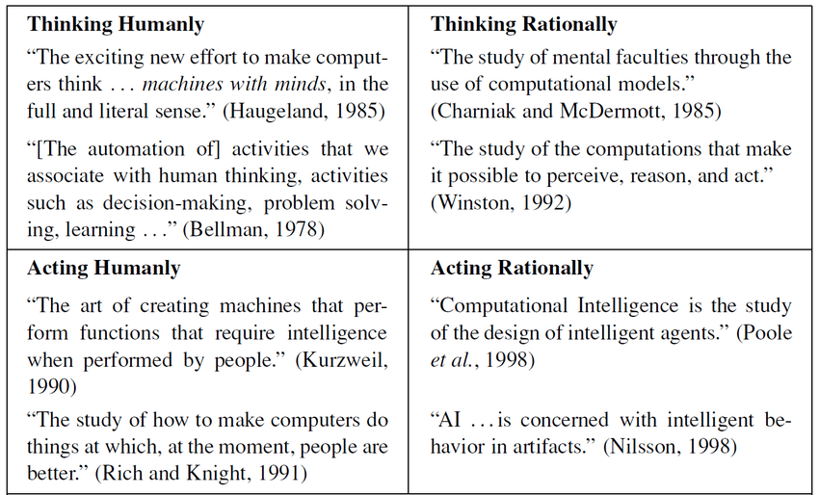
Definitions of Artificial Intelligence

Slide 13
What is Artificial Intelligence ?
THOUGHT
Systems that think
like humans
Systems that think
rationally
Systems that act
like humans
Systems that act
rationally
BEHAVIOUR
HUMAN
RATIONAL

Slide 14
Systems that act like humans:
Turing Test
“The art of creating machines that perform functions that require intelligence when performed by people.” (Kurzweil)
“The study of how to make computers do things at which, at the moment, people are better.” (Rich and Knight)

Slide 15

Systems that act like humans
?
You enter a room which has a computer terminal. You have a fixed period of time to type what you want into the terminal, and study the replies. At the other end of the line is either a human being or a computer system.
If it is a computer system, and at the end of the period you cannot reliably determine whether it is a system or a human, then the system is deemed to be intelligent.

Slide 16
Systems that act like humans
The Turing Test approach
  a human questioner cannot tell if
    there is a computer or a human answering his question, via teletype (remote communication)
  The computer must behave intelligently
Intelligent behavior
  to achieve human-level performance in all cognitive tasks

Slide 17
Systems that act like humans
These cognitive tasks include:
  Natural language processing
    for communication with human
  Knowledge representation
    to store information effectively & efficiently
  Automated reasoning
    to retrieve & answer questions using the stored information
  Machine learning
    to adapt to new circumstances

Slide 18
The total Turing Test
Includes two more issues:
  Computer vision
    to perceive objects (seeing)
  Robotics
    to move objects (acting)

Slide 19
What is Artificial Intelligence ?
THOUGHT
Systems that think
like humans
Systems that think
rationally
Systems that act
like humans
Systems that act
rationally
BEHAVIOUR
HUMAN
RATIONAL

Slide 20
Systems that think like humans: cognitive modeling
Humans as observed from ‘inside’
How do we know how humans think?
  Introspection vs. psychological experiments
Cognitive Science
“The exciting new effort to make computers think … machines with minds in the full and literal sense” (Haugeland)
“[The automation of] activities that we associate with human thinking, activities such as decision-making, problem solving, learning …” (Bellman)

Slide 21
What is Artificial Intelligence ?
THOUGHT
Systems that think
like humans
Systems that think
rationally
Systems that act
like humans
Systems that act
rationally
BEHAVIOUR
HUMAN
RATIONAL

Slide 22
Systems that think ‘rationally’
"laws of thought"
Humans are not always ‘rational’
Rational - defined in terms of logic?
Logic can’t express everything (e.g. uncertainty)
Logical approach is often not feasible in terms of computation time (needs ‘guidance’)
“The study of mental facilities through the use of computational models” (Charniak and McDermott)
“The study of the computations that make it possible to perceive, reason, and act” (Winston)

Slide 23
What is Artificial Intelligence ?
THOUGHT
Systems that think
like humans
Systems that think
rationally
Systems that act
like humans
Systems that act
rationally
BEHAVIOUR
HUMAN
RATIONAL

Slide 24
Systems that act rationally:
“Rational agent”
Rational behavior: doing the right thing
The right thing: that which is expected to maximize goal achievement, given the available information
Giving answers to questions is ‘acting’.
I don't care whether a system:
  replicates human thought processes
  makes the same decisions as humans
  uses purely logical reasoning

Slide 25
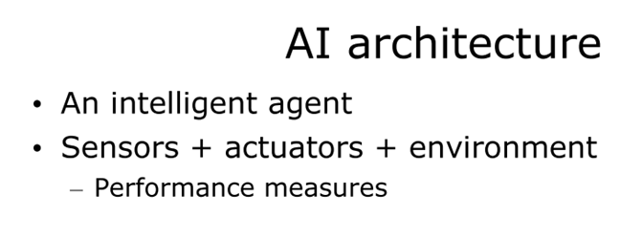
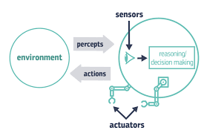

Slide 26
Rational agents
An agent is an entity that perceives and acts
This course is about designing rational agents
Abstractly, an agent is a function from percept histories to actions:
[f: P* → A]
For any given class of environments and tasks, we seek the agent (or class of agents) with the best performance
Caveat: computational limitations make perfect rationality unachievable
  → design best program for given machine resources

Slide 27
Problem Solving
Problem-solving refers to artificial intelligence techniques, including various techniques such as forming efficient algorithms, heuristics, and performing root cause analysis to find desirable solutions.

Slide 28
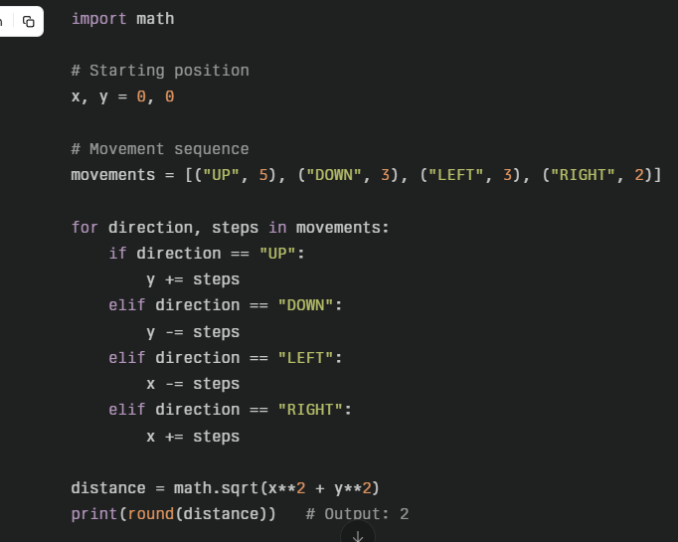
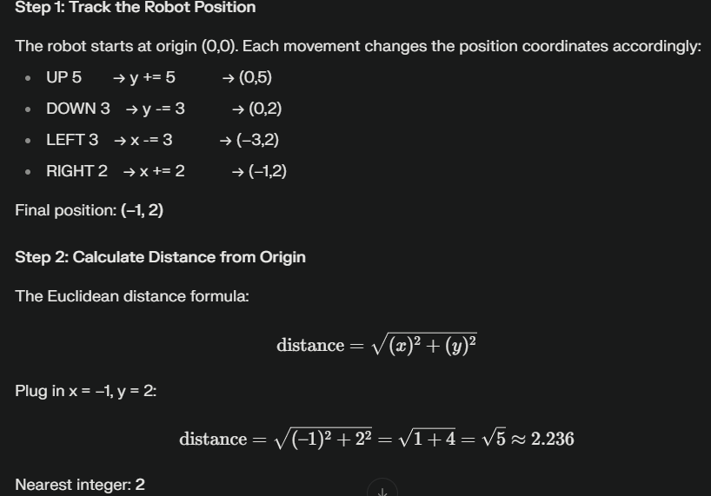
Exercise 1
A robot moves in a plane starting from the original point (0,0). The robot can move toward UP, DOWN, LEFT and RIGHT with a given steps. The trace of robot movement is shown as the following: UP 5, DOWN 3, LEFT 3, RIGHT 2 The numbers after the direction are steps. Please write a program to compute the distance from current position after a sequence of movement and original point. If the distance is a float, then just print the nearest integer

Slide 29
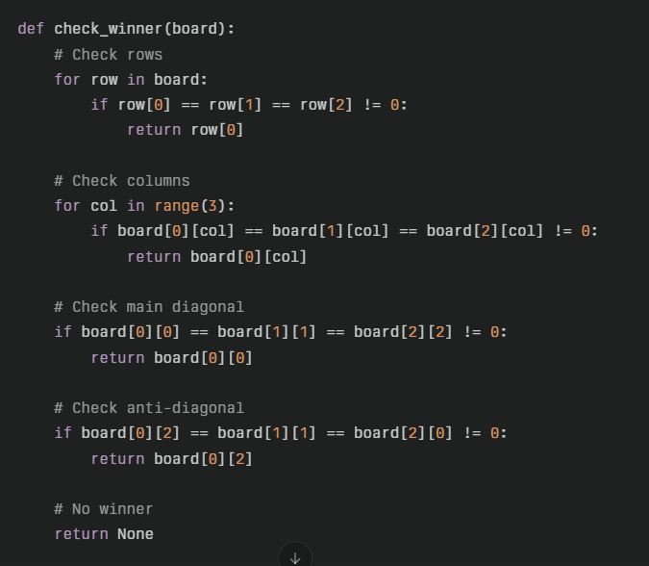
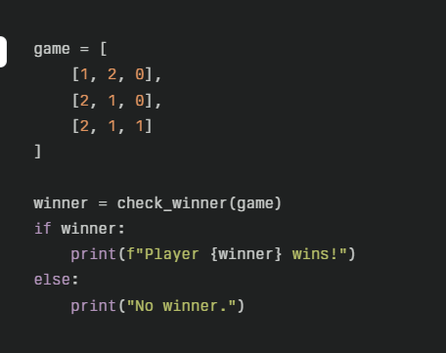
Exercise 2
If a game of Tic Tac Toe is represented as a list of lists, like so:
game = [[1, 2, 0],
[2, 1, 0],
[2, 1, 1]]
where a 0 means an empty square, a 1 means that player 1 put their token in that space, and a 2 means that player 2 put their token in that space. The task is: given a 3 by 3 list of lists that represents a Tic Tac Toe game board A Tic Tac Toe win is 3 in a row - either in a row, a column, or a diagonal. Write a function to check whether, there is a win in current positions of tic tac board
Player 1 wins!

